Slide 1
Level 4_5 – Group 7
George Heath-Collins, Brad Pablo, Katie Millar and George Croucher

Slide 2

Previous Build
https://www.youtube.com/watch?v=XPpZDHPy5YA&feature=youtu.be

Slide 3
Feedback from the previous iteration
It was confusing.
Players never used the whole power bar.
Players weren’t sure when the end of the game was.

Slide 4
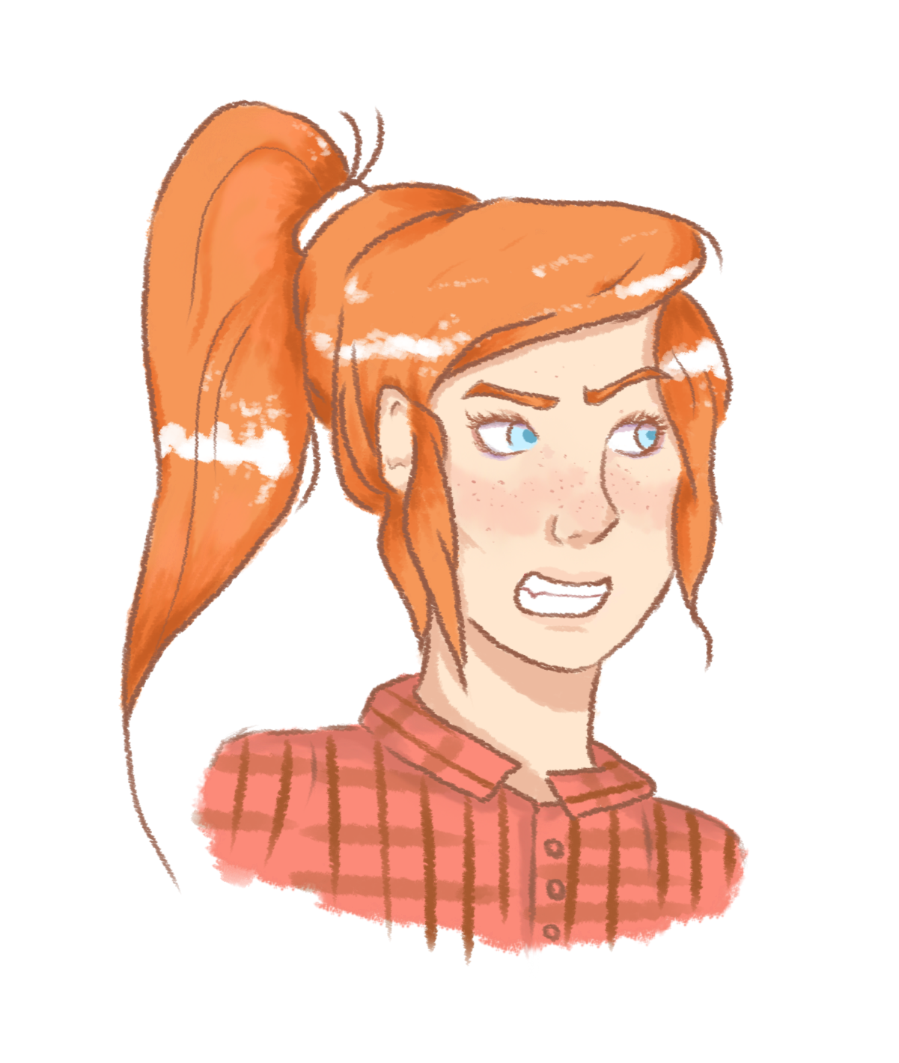
The latest version
https://www.youtube.com/watch?v=Zdp6-2qIw0o

Slide 5
How has the game been iterated?
A focus on visual feedback.
‘Sweet-spot’ system instead of a Power bar.
One player uses the phone at a time.
Comeback system for more skilled players.

Slide 6
Feedback from the latest version
It isn’t clear who has won.
It’s hard to keep track of who is in the lead.
The game doesn’t get more difficult.
Player 1 starts with an advantage.
Trees do not fall over.
Player UI covers the gauge on the screen.
The comeback cursor is too easy to hit.

Slide 7

What will happen in the next 2 weeks?
An increasing difficulty system.
Suitable UI positioning.
Immersive haptic feedback to build tension.
Visual Feedback through refined particle systems and camera movement.

Slide 8
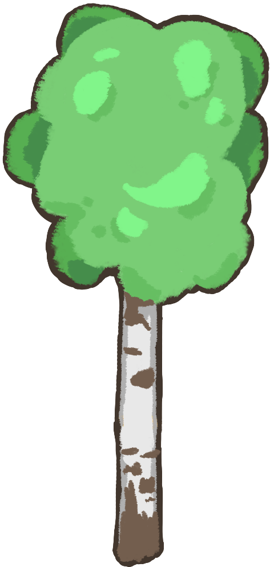
Any Questions?
Thanks for listening!

